Slide 2
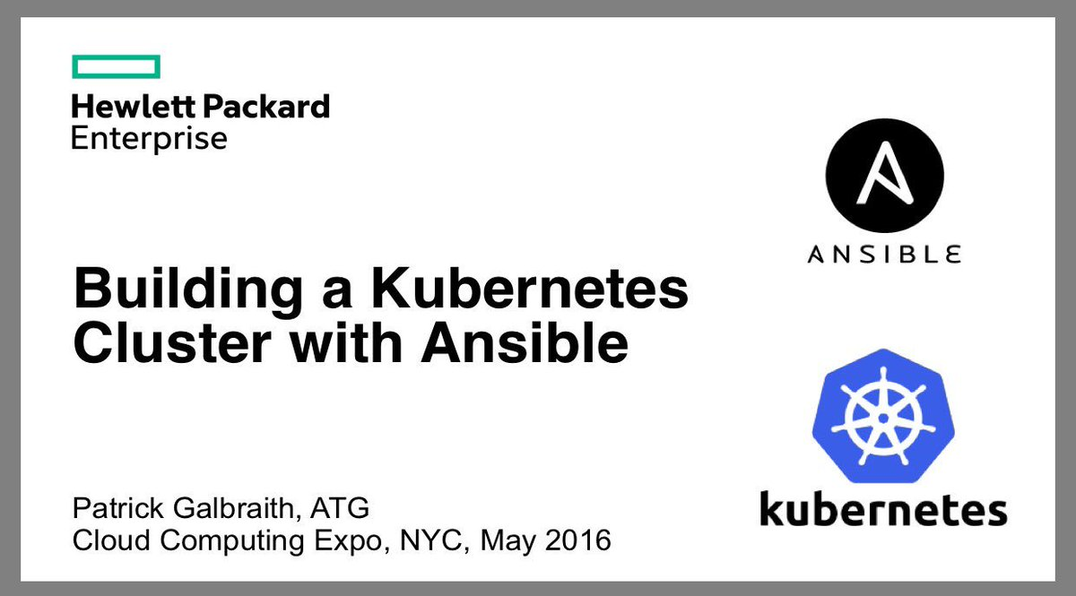

Slide 4

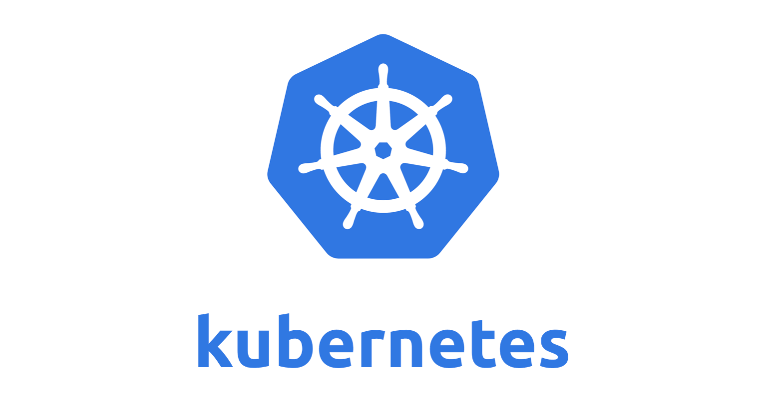
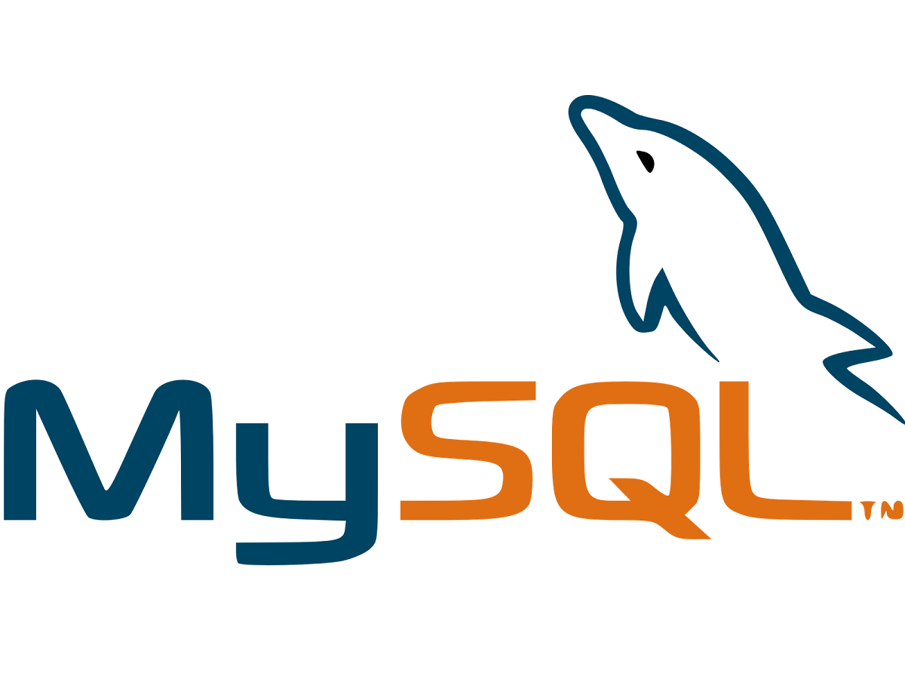
LAUNCHING A WORDPRESS APPLICATION WITH MYSQL DATABASE IN KUBERNETES CLUSTER ON AWS USING ANSIBLE

